Slide 1
Document Oriented Databases
Pravin Y Pawar

Slide 2
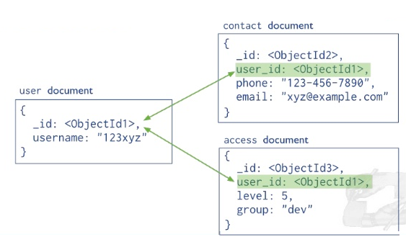
Document based Databases
Document based
Store data in form of documents using well known formats like JSON
Documents accessible via their id, but can be accessed through other index as well
Maintains data in collections of documents
Example,
MongoDB, CouchDB, CouchBase
Book document :
{
“Book Title” : “Database Fundamentals”,
“Publisher” : “My Publisher”,
“Year of Publication” : “2020”
}

Slide 3
What?
MongoDB is
NoSQL
Cross-platform
Distributed
Document-oriented
Open source
Datastore

Slide 4
Why?
Challenges with Relational Databases
Not able to cope with high data volume
Limited capabilities to deal with unstructured data
Restrictions on the scalable needs of enterprise data
Require a Data store that supports
Horizontal scaling
Flexible schema
Partitioning

Slide 5
Why? (2)
Supports auto Sharding
Has Rich Query Language
MongoDB
Supports Replication
Highly Scalable
Does Fast in-place updates

Slide 6
MongoDB and JSON
MongoDB uses BSON (Binary JSON) – Open standard to store complex data structures
Example
Assume following Employee Record is stored in a file
123, Rohit Kumar , 8123561290
124, Naresh Pande , 8904561239
Corresponding JSON representation
{
EmpId : 123,
EmpName : Rohit Kumar,
ContactNo : 8123561290
}
{
EmpId : 124,
EmpName : Naresh Pande ,
ContactNo : 8904561239
}

Slide 7
MongoDB concepts
Database, Collection and Document
Database
Collection of collections
Container for collections
Gets created when its referenced or can be manually created on demand
Collection
Similar to table in RDBMS
Holds multiple documents within it
No enforcement of Schema
Gets created when its referenced or can be manually created on demand
Document
Similar to row in RDBMS table
Has a unique identifier
Supports dynamic schema

Slide 8
MongoDB Features
Auto Sharding
Similar to Horizontal scaling
Dataset is divided and distributed over multiple nodes or shards
Each shard is independent database
Collectively all databases constitutes the logical database
Reduces the number of operations that each shard handles
1 TB Collection
Shard1 256 GB
Shard2 256 GB
Shard3 256 GB
Shard4 256 GB

Slide 9
MongoDB Features(2)
Rich Query Language
For read and write operations (CRUD)
Data Aggregation
Text Search and Geospatial Queries

Slide 10
MongoDB Features(3)
Replication
Supports data redundancy and high availability
Helps to recover from hardware failure and service interruptions
Replica has single primary and several secondary's
Working
Write is directed to primary
Primary then logs all write requests to OpLogs (operations logs)
OpLog is used by secondary replicas to synchronize their data
Clients read from primary
Client can specify a read preference to a secondary
Client
Writes
Reads
Primary
Replication
Replication
Secondary
Secondary
Secondary

Slide 11
MongoDB Features(4)
Scalability
Stores data in binary format (BSON)
Provides GridFS to support storage of data
Can easily store photographs, small audio clips
Stores metadata in a collection called “file”
Breaks the data into small pieces called “chunks”
“Chunks” are stored in “chunks” collection
This process takes care about need for easy scalability

Slide 12
MongoDB Features(5)
In-place data updates
Updates data in-place
Means updates the data wherever it is available
Does it by lazy writes
Writes to disk once every second
Fewer reads and writes to disk hence performance is better
No guarantee that data will be stored safely on the disk

Slide 13
Thank You!
In our next session: Columnar Databases

